Slide 1
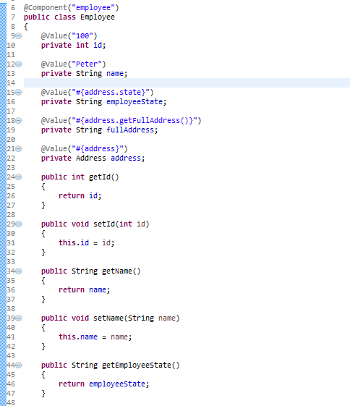
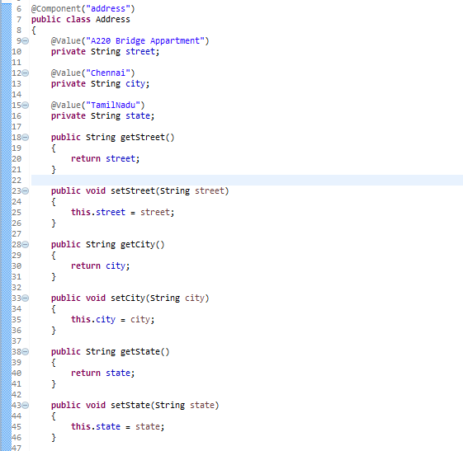
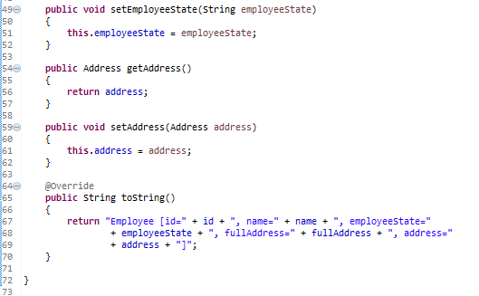
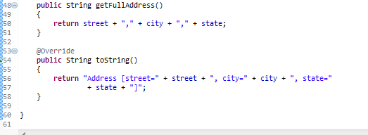
Spring EL bean reference example-Annotation
In Spring EL, you can reference a bean, and nested properties using a ‘dot (.)‘ symbol. For example, “bean.property_name“.

Slide 2
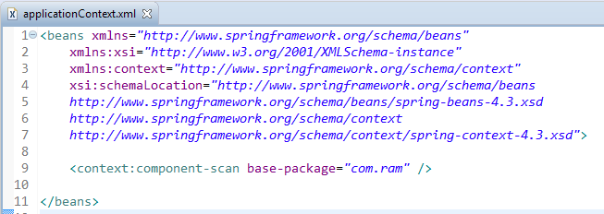
Spring EL bean reference example-Annotation
Enable auto component scanning.

Slide 3
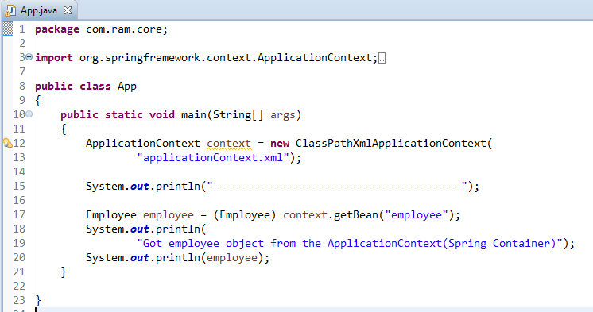
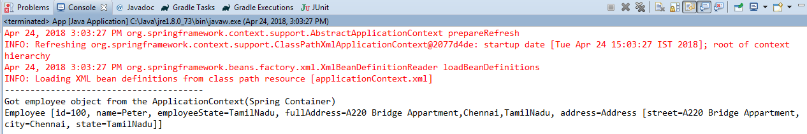
Spring EL bean reference example-Annotation

